Slide 1

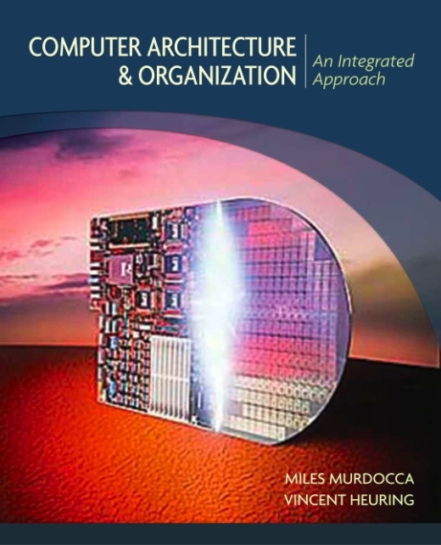
Computer Organisation and Architecture
Chapter 6 – Languages and the Machine

Slide 2
Chapter Contents
    The Compilation Process
    The Assembly Process

Slide 3
The Compilation Process
  • Compilation translates a program written in a high level language into a functionally equivalent program in assembly language.
  • Consider a simple high-level language assignment statement:
  A = B + 4;
  • Steps involved in compiling this statement into assemby code:
  — Reducing the program text to the basic symbols of the language (for example, into identifiers such as A and B), denotations such as the constant value 4, and program delimiters such as = and +. This portion of compilation is referred to as lexical analysis.
  — Parsing symbols to recognize the underlying program structure. For the statement above, the parser must recognize the form:
  Identifier “=” Expression,
  where Expression is further parsed into the form:
  Identifier “+” Constant.
  Parsing is sometimes called syntactic analysis.

Slide 4
The Compilation Process
  — Name analysis: associating the names A and B with particular program variables, and further associating them with particular memory locations where the variables are located at run time.
  — Type analysis: determining the types of all data items. In the example above, variables A and B and constant 4 would be recognized as being of type int in some languages. Name and type analysis are sometimes referred to together as semantic analysis: determining the underlying meaning of program components.
  — Action mapping and code generation: associating program statements with their appropriate assembly language sequence. In the statement above, the assembly language sequence might be as follows:
  ld [B], %r0, %r1 ! Get variable B into a register.
  add %r1, 4, %r2 ! Compute the value of the expression
  st %r2, %r0, [A] ! Make the assignment.

Slide 5
The Assembly Process
  • The process of translating an assembly language program into a machine language program is referred to as the assembly process.
  • Production assemblers generally provide this support:
  — Allow programmer to specify locations of data and code.
  — Provide assembly-language mnemonics for all machine instructions and addressing modes, and translate valid assembly language statements into the equivalent machine language.
  — Permit symbolic labels to represent addresses and constants.
  — Provide a means for the programmer to specify the starting address of the program, if there is one; and provide a degree of assemble-time arithmetic.
  — Include a mechanism that allows variables to be defined in one assembly language program and used in another, separately assembled program.
  — Support macro expansion.

Slide 6
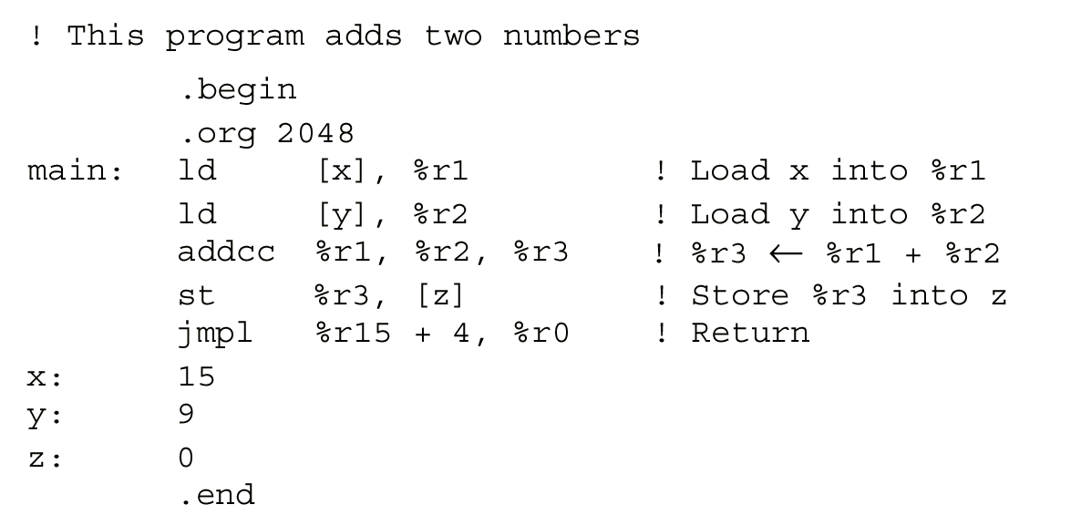
Assembly Example
  • We explore how the assembly process proceeds by “hand assembling” a simple ARC assembly language program.

Slide 7
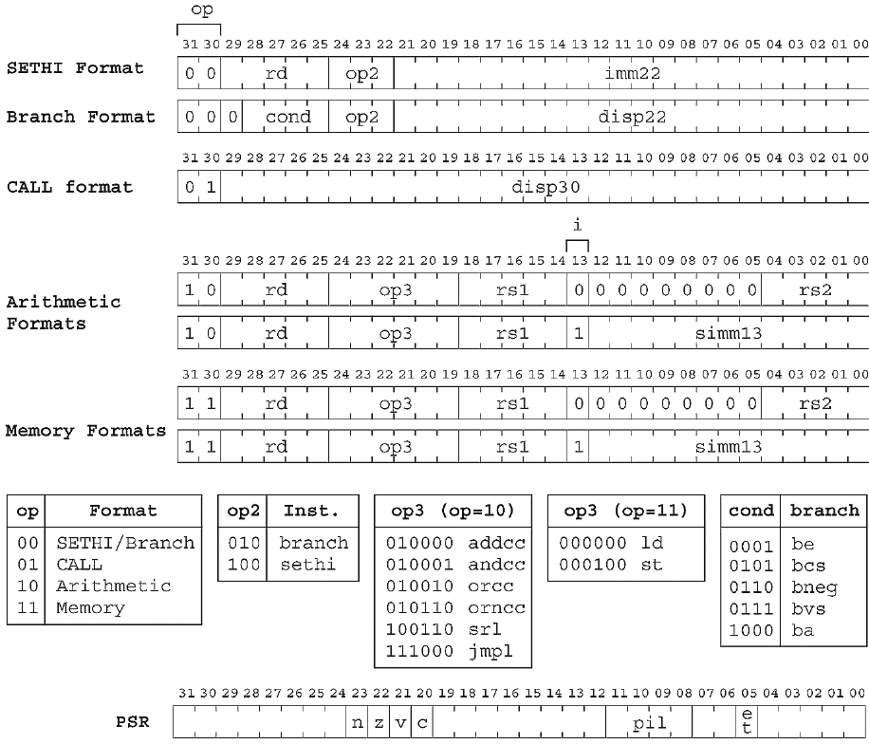
Instruc-tion
For-mats and PSR Format for the ARC

Slide 8
Assembled Code
  ld [x], %r1 1100 0010 0000 0000 0010 1000 0001 0100
  ld [y], %r2 1100 0100 0000 0000 0010 1000 0001 1000
  addcc %r1,%r2,%r3 1000 0110 1000 0000 0100 0000 0000 0010
  st %r3, [z] 1100 0110 0010 0000 0010 1000 0001 1100
  jmpl %r15+4, %r0 1000 0001 1100 0011 1110 0000 0000 0100
  15 0000 0000 0000 0000 0000 0000 0000 1111
  9 0000 0000 0000 0000 0000 0000 0000 1001
  0 0000 0000 0000 0000 0000 0000 0000 0000

Slide 9
